Slide 1
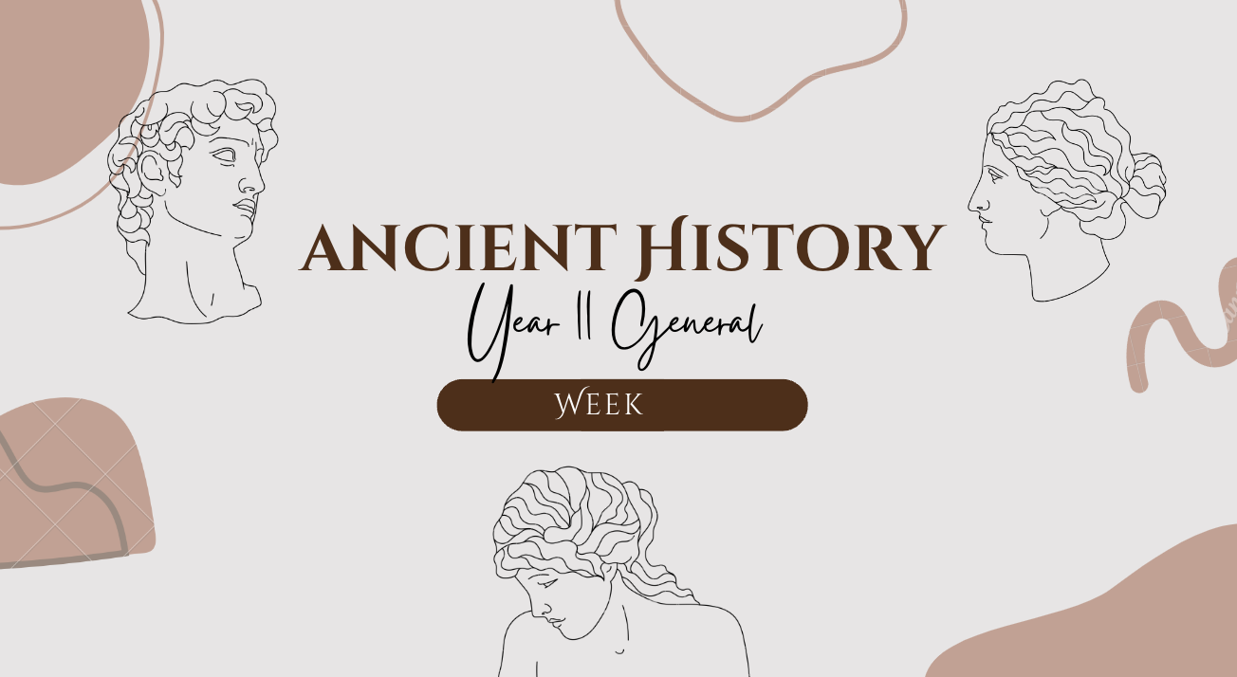
1
TITLE: Greek Civilisations
GOAL/S: identify the features of ancient greece
Lesson 3
Ms Barrie

Slide 2
Today’s Lesson
Broad overview of the historical context for the ancient civilisation
The geographical location of Greece and Troy (including key sites)

Slide 3
REVIEW: What we are studying?
Unit 1: ANCIENT CIVILISATIONS – Late Bronze Age Greece and Troy c. 1500–c. 1050 BCE

Slide 4
1. Late Bronze Age 2. Greece and Troy 3. c. 1500–c. 1050 BCE

Slide 5
The Bronze Age
Social, economic, and technological advances in Greece
Hub of Mediterranean
3 Key civilisations of the time:
Cycladic (Cyclades)
Minoan (Crete)
Helladic/Mycenaean (mainland) – the ‘Age of Heroes’
END OF AGE: Rise of the mysterious ‘Dorians’
swept away the cultures that had gone before them
Notes:
called “Age of Heroes” because it is the source of the mythological heroes and epics like Hercules, the Iliad and the Odyssey.

Slide 6

Why is it called the ‘Bronze’ Age?
The Bronze Age was the time from around 2,000BC to 700BC when people used bronze.
In the Stone Age, flint was shaped and used as tools and weapons, but in the Bronze Age, stone was gradually replaced by bronze.
Bronze was made by melting tin and copper, and mixing them together.

Slide 7
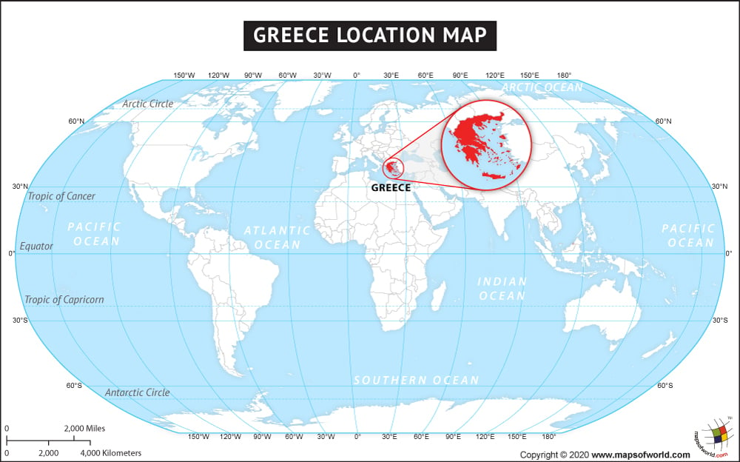

Slide 8
Mapping Activity - Greece
On the Map provided, label the following important locations.
Glue in your book once complete.

Slide 9
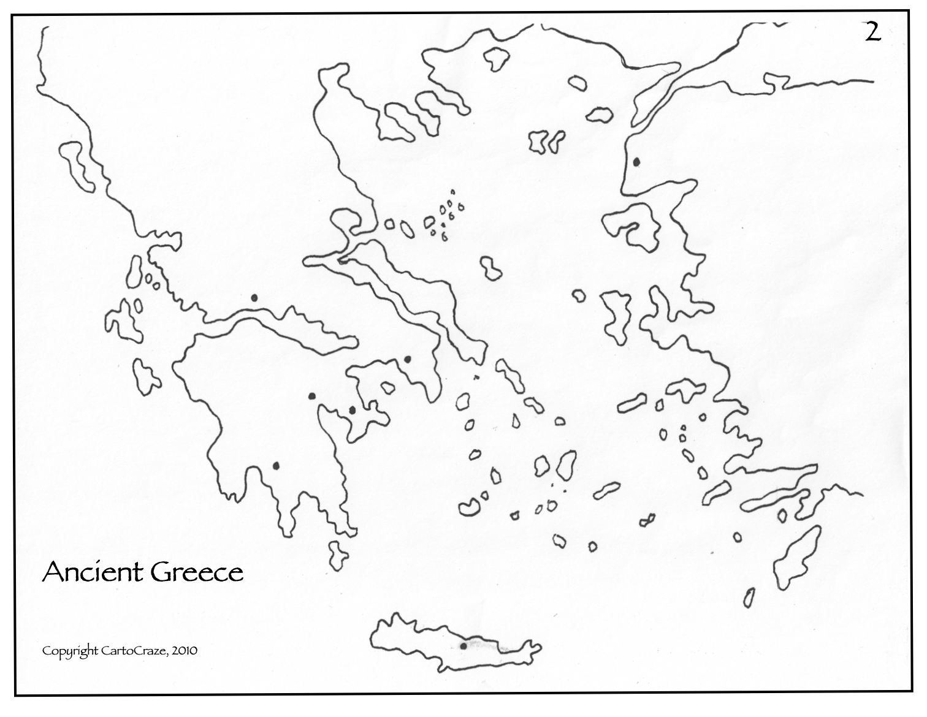

Slide 10
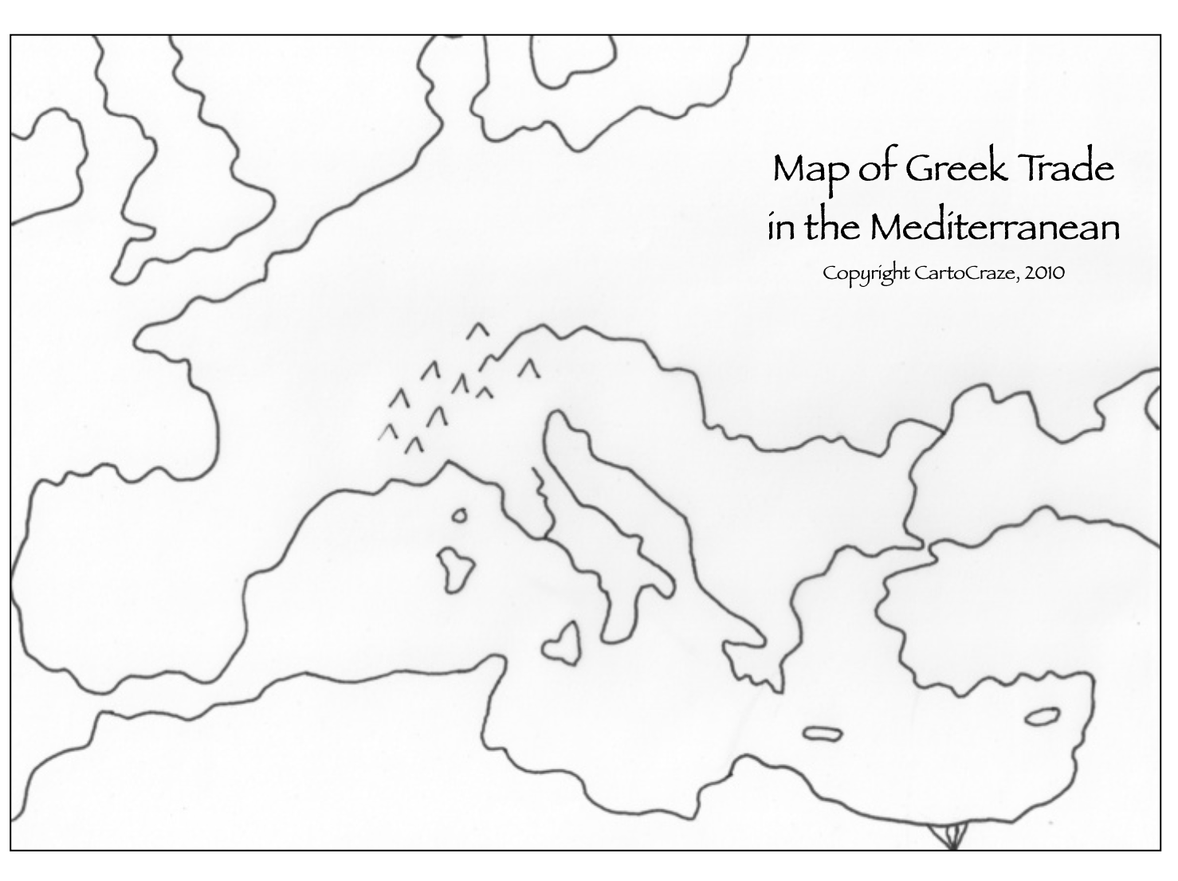

Slide 11
What are some things you notice about Greek geography?
Discussion question:

Slide 12

Greece became a major hub of activity in the Mediterranean during the Bronze Age. Greek communities often developed independently because of the mountains. Thus, they were diverse. As a result, they fought each other a lot.

Slide 13
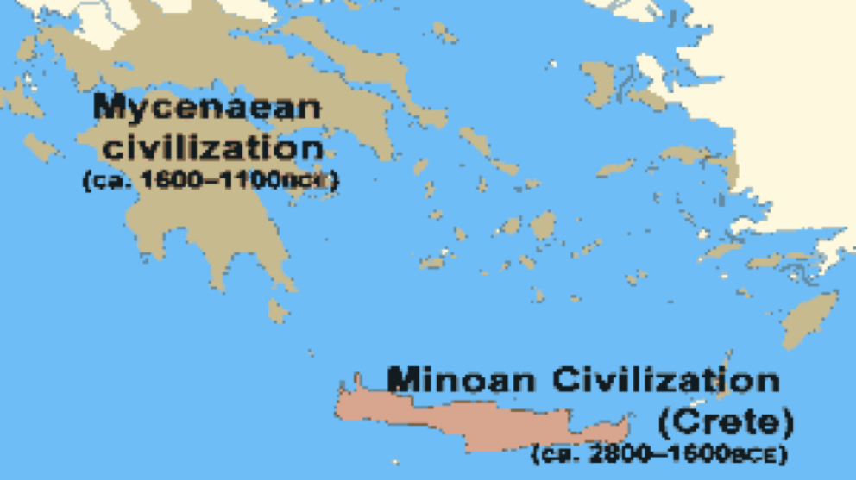

Slide 14
SUMMARY
Identify the historical context of Bronze Age Greece.
List any KEY PEOPLE
List any KEY EVENTS
List any KEY IDEAS

